Slide 1
Class diagram

Slide 2
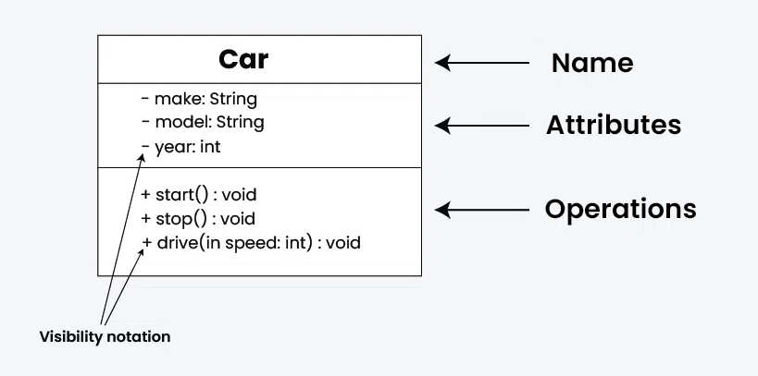

Slide 3
Class Name:
The name of the class is typically written in the top compartment of the class box and is centered and bold.
Attributes:
Attributes, also known as properties or fields, represent the data members of the class. They are listed in the second compartment of the class box and often include the visibility (e.g., public, private) and the data type of each attribute.

Slide 4
Methods:
Methods, also known as functions or operations, represent the behavior or functionality of the class. They are listed in the third compartment of the class box and include the visibility (e.g., public, private), return type, and parameters of each method.

Slide 5
Visibility Notation:
Visibility notations indicate the access level of attributes and methods. Common visibility notations include:
+ for public (visible to all classes)
- for private (visible only within the class)
# for protected (visible to subclasses)
~ for package or default visibility (visible to classes in the same package)

Slide 6
Parameter Directionality
In class diagrams, parameter directionality refers to the indication of the flow of information between classes through method parameters. It helps to specify whether a parameter is an input, an output, or both. This information is crucial for understanding how data is passed between objects during method calls.

Slide 7
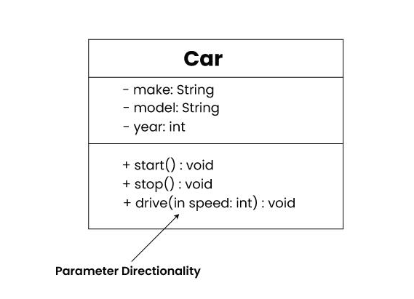
Parameter Directionality

Slide 8
In (Input):
An input parameter is a parameter passed from the calling object (client) to the called object (server) during a method invocation.
It is represented by an arrow pointing towards the receiving class (the class that owns the method).
Out (Output):
An output parameter is a parameter passed from the called object (server) back to the calling object (client) after the method execution.
It is represented by an arrow pointing away from the receiving class.

Slide 9
InOut (Input and Output):
An InOut parameter serves as both input and output. It carries information from the calling object to the called object and vice versa.
It is represented by an arrow pointing towards and away from the receiving class.

Slide 10
Relationships between classes
In class diagrams, relationships between classes describe how classes are connected or interact with each other within a system. There are several types of relationships in object-oriented modeling, each serving a specific purpose. Here are some common types of relationships in class diagrams:

Slide 11
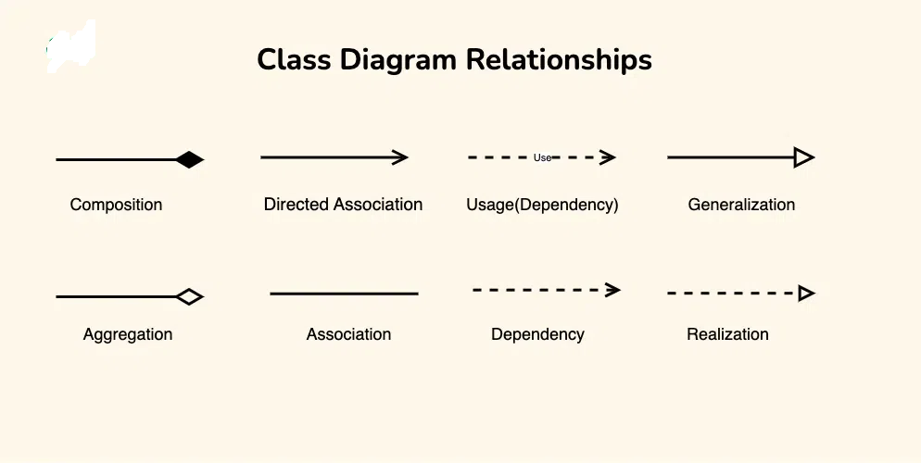

Slide 12
